Slide 1
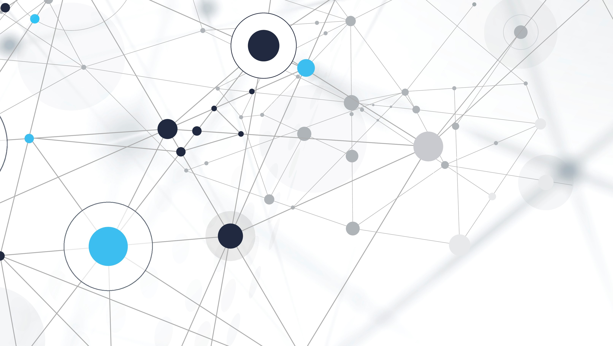
Brain Tumor Detection Using CNN
Karan Gautam

Slide 2
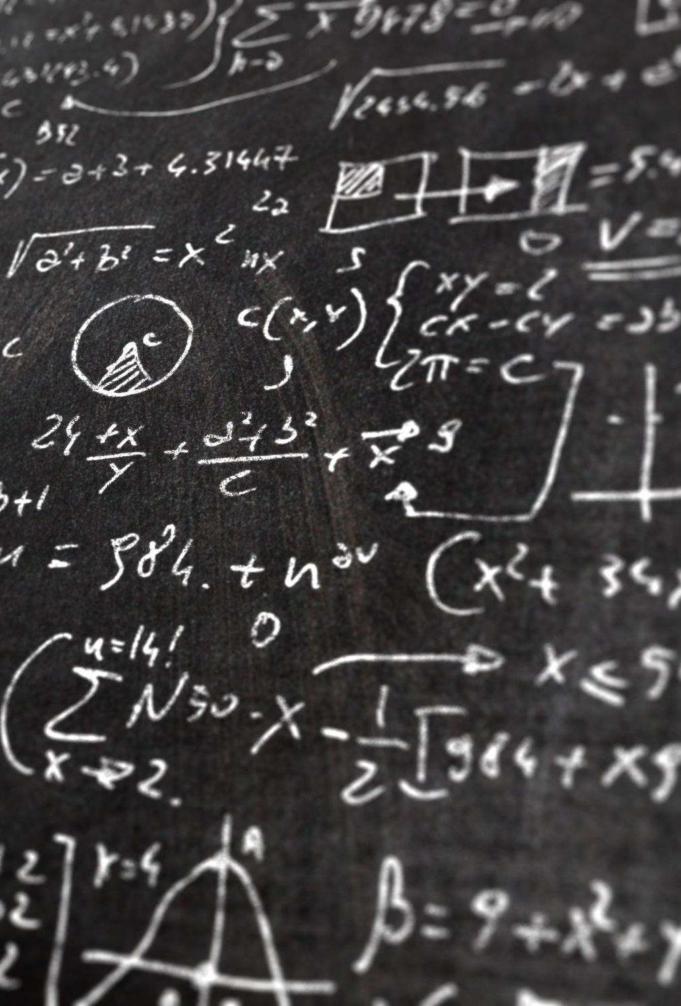
Outlines
Project Overview
Data Source
Exploratory Data Analysis
Algorithms and Techniques
Methodology
Model Evaluation and Validation
Conclusion

Slide 3
Project Overview
Due to the increasing amounts of electronic data in the healthcare, life sciences, and bioscience industry, medical doctors and physicians are facing problems in analyzing the data using traditional diagnosing systems. Nevertheless, machine learning and deep learning techniques have aided doctors and experts in detecting deadly diseases in their early stages.
A brain tumor is the growth of abnormal cells in the brain tissues. It can be cancerous and non-cancerous. The brain tumor is the most dangerous disease and can be diagnosed efficiently and reliably with the help of technology. We can use automated techniques on MRI Images for accurate detection of brain tumors.
The aim of this project is to build a Brain Tumor detection model using a Convolutional Neural Network using the Brain MRI Images Dataset.

Slide 4
Data Source
The dataset that will be used in this project is Brain MRI Images for Brain Tumor Detection. This dataset will be obtained from Kaggle. The dataset encompasses two folders named "yes" and "no." These folders collectively contain 253 brain MRI images. The images are grayscale and come in different sizes, i.e., they have distinct widths, heights, and the number of channels. The folder "yes" consists of 155 tumorous brain MRI images, and the folder "no" consists of 98 non-tumorous brain MRI images.

Slide 5
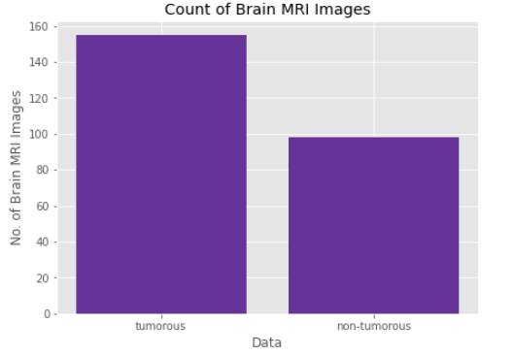
Exploratory Data Analysis
The Brain MRI Images for Brain Tumor Detection dataset consists of two classes of images: tumorous and non-tumorous. To visualize the count of data points/ images, I have plotted a bar plot for it shows the count of brain MRI images in the original dataset.

Slide 6
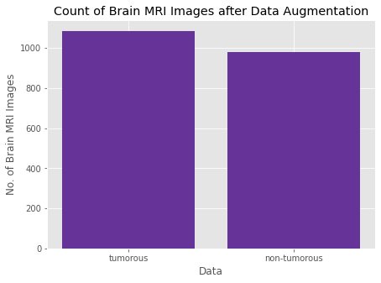
Data augmentation
The initial dataset was imbalanced and unsuitable for training the model. Therefore, I performed data augmentation to increase and balance the data. The graph illustrates the count of brain MRI images after data augmentation. From the plot, we can infer that the new dataset consists of 2065 images, with 1085 images belonging to the tumorous class and 980 images belonging to the non-tumorous class.

Slide 7
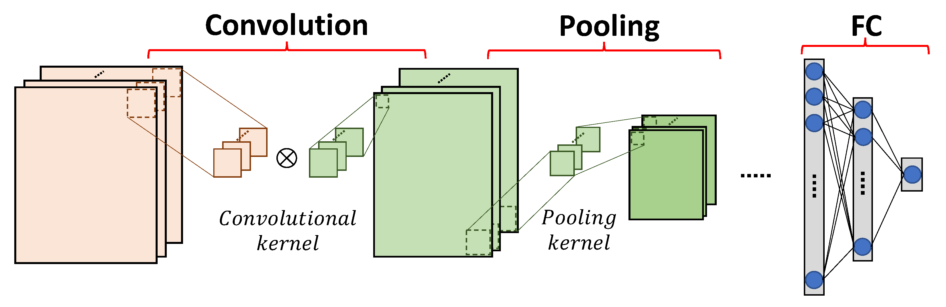
Algorithms and Techniques
A Convolutional Neural Network (CNN) model is used in this problem. Convolutional Neural Network aspires to process data with a grid structure. CNN consists of three-layer types: the Convolutional Layer, Pooling Layer, and Fully Connected Layer. The convolutional layer is the most essential and the primary layer in the CNN architecture. Next, to reduce the dimensionality of the feature map, the pooling layer comes into play. Lastly, the outputs from the final pooling layer or the convolutional layer are fed as the input to the fully connected layer after flattening

Slide 8
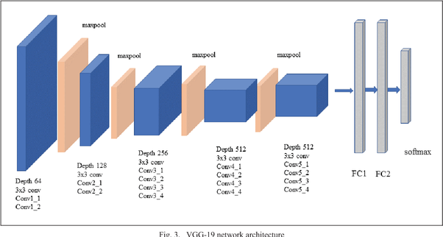
Algorithms and Techniques
Transfer learning has been performed in this project. It is a machine learning technique in which we reuse a pre-trained model as the commencing point for a model on a new task. We have built 2 models using VGG19 CNN architecture and fine-tuned them using transfer learning.
In this project, to classify brain MRI images into tumorous and non-tumorous, we have used VGG19 CNN architecture. It is a 19-layers deep convolutional neural network. VGG19 is an advanced convolutional neural network with pre-trained layers.

Slide 9
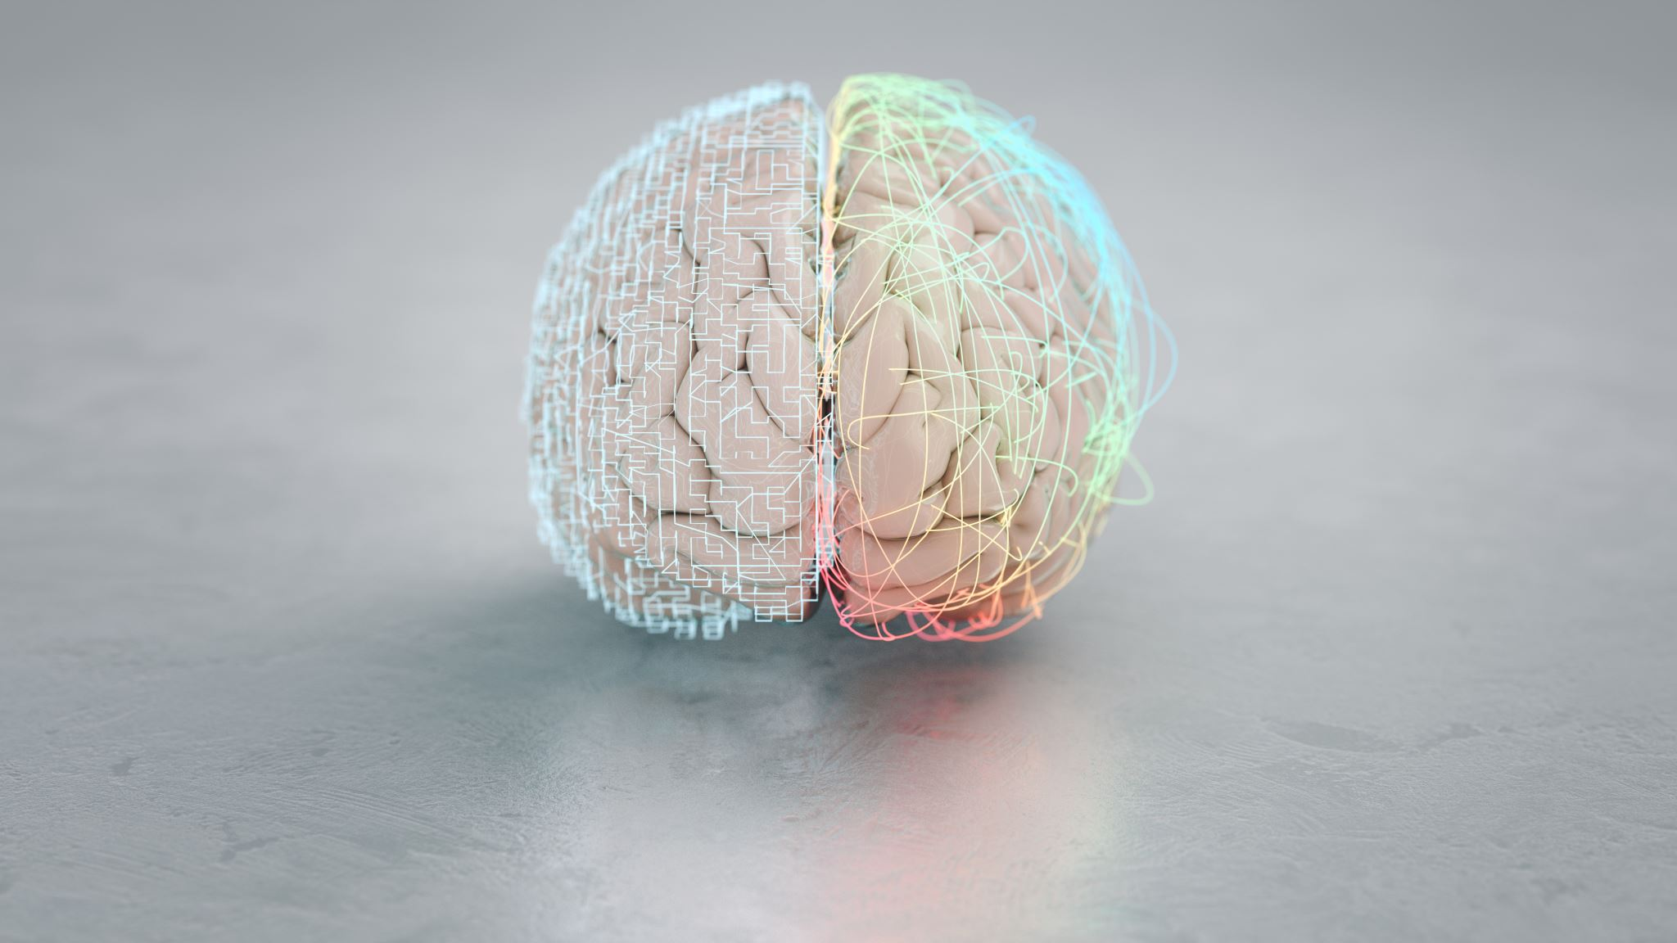
Methodology
Data Preprocessing
The preprocessing of data consists of the following steps:
1. To compute the extreme points along the contour of the brain in the image, apply a cropping strategy using OpenCV. Crop the part of the image that represents only the brain.
2. Resize the images as they come in distinct sizes from the dataset. Resize all our images to (240, 240, 3) to feed them as input to the Convolutional Neural Network.
3. Apply normalization techniques as we want to scale the pixel values in the range 0-1.
4. Append the label to y and the image to X.
5. Shuffle X and y as the data is ordered, meaning the first part of the array belongs to one class and the second part belongs to the other, and we don't desire that.
6. Split X and y into training, validation, and test set by 70%, 15%, and 15%.

Slide 10
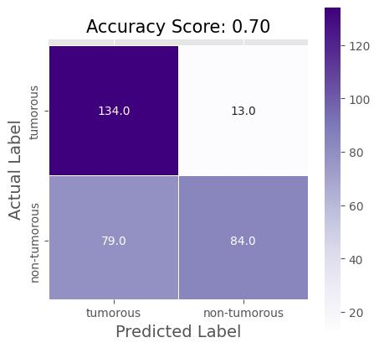
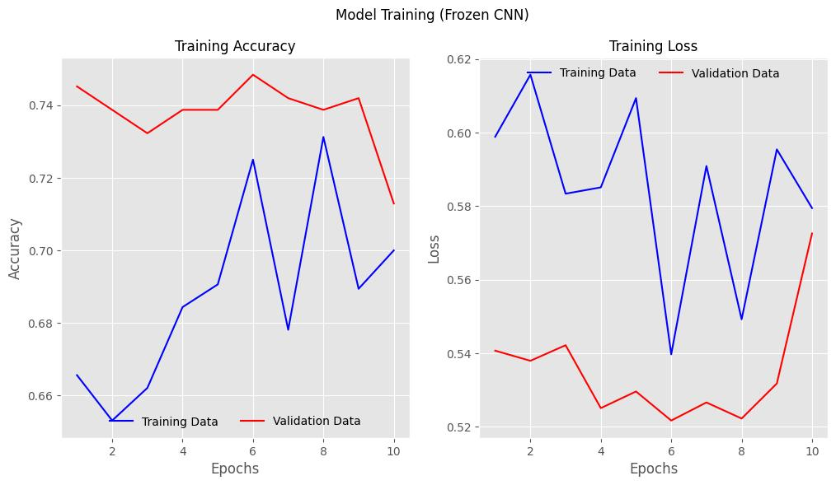


Model Evaluation and Validation
Model 1: Frozen CNN

Slide 11
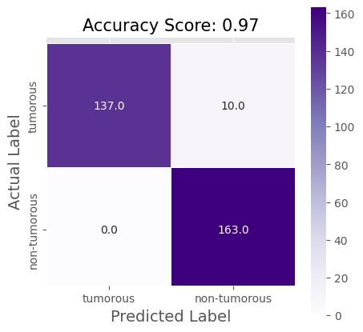
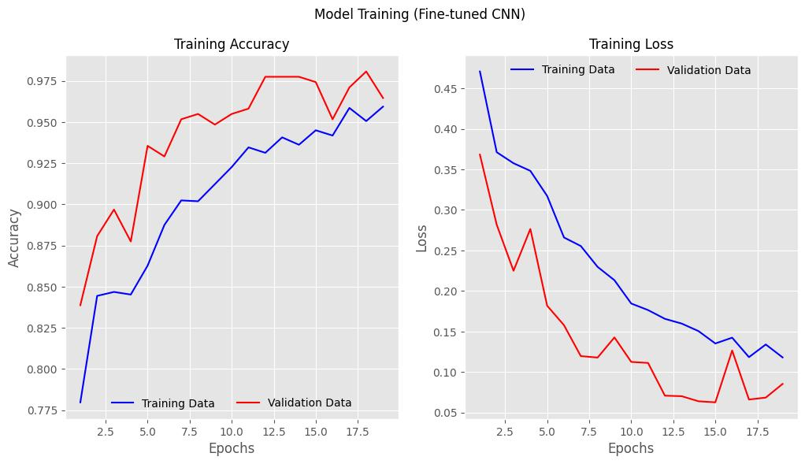


Model Evaluation and Validation
Model 2: Unfreezing and fine-tuning the entire network

Slide 12
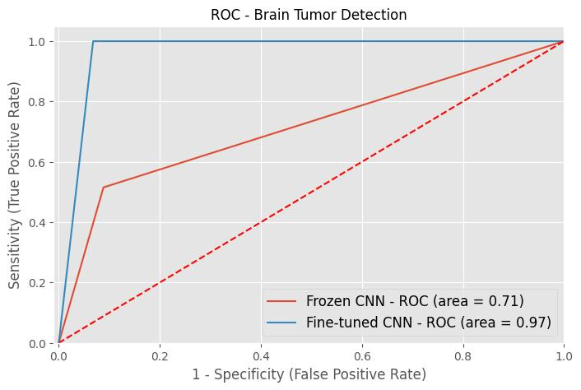
Model Evaluation and Validation
AUC-ROC Curve

Slide 13

Conclusion
Disease prediction has the potential to become a stakeholder's asset. These include health insurance companies, government, etc. It identifies patients at risk of hazardous disease, which then helps the physicians and clinicians take suitable actions to avoid or minimize the risk. In this project, we have built a VGG19 CNN model using transfer learning and the best model was built after fine-tuning. Our model gave a test accuracy of 96.00% and a training accuracy of 100%. The F1 Score of this model is 97.02% and the AUC is 97.00%. This model can be deployed in a web application for the prediction of brain tumors. This web app will be extremely useful for doctors and physicians in accurately predicting brain tumors from MRI images of patients.

Slide 14
Thank you

